Slide 1
Memory Systems

Slide 2
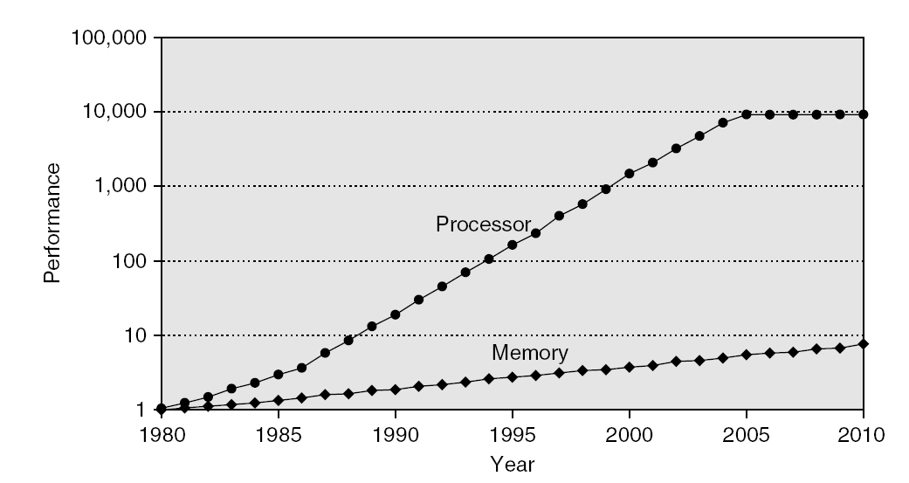
Memory Performance Gap
Introduction

Slide 3
The Goal: illusion of large, fast, cheap memory
Fact: Large memories are slow, fast memories are small
How do we create a memory that is large, cheap and fast (most of the time)?
  Hierarchy
  Parallelism

Slide 4
An Expanded View of the Memory System
Processor
Control
Memory
Memory
Datapath
Memory
Memory
Memory
Speed:
Fastest
Slowest
Size:
Smallest
Biggest
Cost:
Highest
Lowest

Slide 5
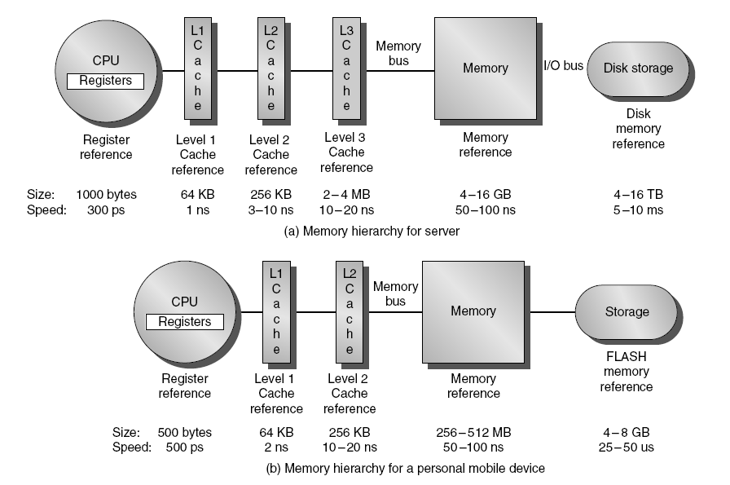
Memory Hierarchy
Introduction

Slide 6
Why hierarchy works
The Principle of Locality:
  Program accesses a relatively small portion of the address space at any instant of time.
Probability
of reference
0
Address Space
2^n - 1

Slide 7
Memory Hierarchy: How Does it Work?
Temporal Locality (Locality in Time):
  => Keep most recently accessed data items closer to the processor
Spatial Locality (Locality in Space):
  => Move blocks consists of contiguous words to the upper levels
Lower Level
Memory
To Processor
Upper Level
Memory
Blk X
From Processor
Blk Y

Slide 8
Memory Hierarchy: Terminology
Hit: data appears in some block in the upper level (example: Block X)
  Hit Rate: the fraction of memory access found in the upper level
  Hit Time: Time to access the upper level which consists of
    RAM access time + Time to determine hit/miss
Miss: data needs to be retrieved from a block in the lower level (Block Y)
  Miss Rate = 1 - (Hit Rate)
  Miss Penalty: Time to replace a block in the upper level +
    Time to deliver the block to the processor
Hit Time << Miss Penalty
Lower Level
Memory
To Processor
Upper Level
Memory
Blk X
From Processor
Blk Y
Notes:
A HIT is when the data the processor wants to access is found in the upper level (Blk X).
The fraction of the memory access that are HIT is defined as HIT rate.
HIT Time is the time to access the Upper Level where the data is found (X). It consists of:
(a) Time to access this level.
(b) AND the time to determine if this is a Hit or Miss.
If the data the processor wants cannot be found in the Upper level. Then we have a miss and we need to retrieve the data (Blk Y) from the lower level.
By definition (definition of Hit: Fraction), the miss rate is just 1 minus the hit rate.
This miss penalty also consists of two parts:
(a) The time it takes to replace a block (Blk Y to BlkX) in the upper level.
(b) And then the time it takes to deliver this new block to the processor.
It is very important that your Hit Time to be much much smaller than your miss penalty. Otherwise, there will be no reason to build a memory hierarchy.

Slide 9
How is the hierarchy managed?
Registers <-> Memory
  by compiler (programmer?)
cache <-> memory
  by the hardware
memory <-> disks
  by the hardware and operating system (virtual memory)
  by the programmer (files)

Slide 10
Memory Hierarchy Technology
Random Access:
  “Random” is good: access time is the same for all locations
  DRAM: Dynamic Random Access Memory
    High density, low power, cheap, slow
    Dynamic: need to be “refreshed” regularly
  SRAM: Static Random Access Memory
    Low density, high power, expensive, fast
    Static: content will last “forever”(until lose power)
“Non-so-random” Access Technology:
  Access time varies from location to location and from time to time
  Examples: Disk, CDROM
Sequential Access Technology: access time linear in location (e.g.,Tape)

Slide 11
Static RAM Cell
6-Transistor SRAM Cell
word
word
(row select)
0
1
0
1
bit
bit
Write:
  1. Drive bit lines (bit=1, bit=0)
  2.. Select row
Read:
  1. Precharge bit and bit to Vdd/2
  2.. Select row
  3. Cell pulls one line low
  4. Sense amp on column detects difference between bit and bit
bit
bit
Notes:
The classical SRAM cell looks like this. It consists of two back-to-back inverters that serves as a flip-flop. Here is an expanded view of this cell, you can see it consists of 6 transistors.
In order to write a value into this cell, you need to drive from both sides. For example, if you want to write a 1, you will drive “bit” to 1 while at the same time, drive “bit bar” to zero.
Once the bit lines are driven to their desired values, you will turn on these two transistors by setting the word line to high so the values on the bit lines will be written into the cell.
Remember now these are very very tiny transistors so we cannot rely on them to drive these long bit lines effectively during read.
Also, the pull down devices are usually much stronger than the pull up devices. So the first thing we need to do on read is to charge these two bit lines to a high values.
Once these bit lines are charged to high, we will turn on these two transistors so one of these inverters (the lower one in our example) will start pulling one of the bit line low while the other bit line will remain at HI.
It will take this small inverter a long time to drive this long bit line to low but we don’t have to wait that long since all we need to detect the difference between these two bit lines.
And if you ask any circuit designer, they will tell you it is much easier to detect a “differential signal” (point to bit and bit bar) than to detect an absolute signal.

Slide 12
Typical SRAM Organization: 16-word x 4-bit
Din 3
Din 2
Din 1
Din 0
WrEn
Precharge
Wr Driver &
Precharger
Wr Driver &
Precharger
Wr Driver &
Precharger
Wr Driver &
Precharger
-
+
-
+
-
+
-
+
Word 0
A0
SRAM
Cell
SRAM
Cell
SRAM
Cell
SRAM
Cell
A1
Address Decoder
Word 1
A2
SRAM
Cell
SRAM
Cell
SRAM
Cell
SRAM
Cell
A3
:
:
:
:
Word 15
SRAM
Cell
SRAM
Cell
SRAM
Cell
SRAM
Cell
-
+
-
+
-
+
-
+
Q: Which is longer:
word line or
bit line?
Sense Amp
Sense Amp
Sense Amp
Sense Amp
Dout 3
Dout 2
Dout 1
Dout 0
Notes:
This picture shows you how to connect the SRAM cells into a 15-word by 4-bit SRAM array.
The word lines are connected horizontally to the address decoder while the bit lines are connected vertically to the sense amplifier and write driver.
**** What do you think is longer? Word line or bit line ****
Since a typical SRAM will have thousands if not millions of words (vertical) and usually be less than 10s of bits, the bit line will be much much much longer than the word line.
This is bad because if we have a large load on the word line (large capacitance), we can always build a bigger address decoder to drive them no sweat.
But for the bit lines, we still have to rely on the tiny transistors (SRAM cell). That’s why we need to precharge them to high and use sense amp to detect the differences.
Read enable is not needed here because if Write Enable is not asserted, read is by default.(Don’t need Read Enable)
The internal logic will detect an address changes and precharge the bit lines. Once the bit lines are precharged, the values of the new address will appear at the Dout pin.

Slide 13
1-Transistor Memory Cell (DRAM)
row select
Write:
  1. Drive bit line
  2.. Select row
Read:
  1. Precharge bit line to Vdd
  2.. Select row
  3. Cell and bit line share charges
    Very small voltage changes on the bit line
  4. Sense (fancy sense amp)
    Can detect changes of ~1 million electrons
  5. Write: restore the value
Refresh
  1. Just do a dummy read to every cell.
bit
Notes:
The state of the art DRAM cell only has one transistor. The bit is stored in a tiny transistor.
The write operation is very simple. Just drive the bit line and select the row by turning on this pass transistor.
For read, we will need to precharge this bit line to high and then turn on the pass transistor.
This will cause a small voltage change on the bit line and a very sensitive amplifier will be used to measure this small voltage change with respect to a reference bit line.
Once again, the value we stored will be destroyed by the read operation so an automatic write back has to be performed at the end of every read.

Slide 14
Classical DRAM Organization (square)
bit (data) lines
r
o
w
d
e
c
o
d
e
r
Each intersection represents
a 1-T DRAM Cell
RAM Cell
Array
word (row) select
row
address
Column Selector &
I/O Circuits
Column
Address
Row and Column Address together:
  Select 1 bit a time
data
Notes:
Similar to SRAM, DRAM is organized into rows and columns.
But unlike SRAM, which allows you to read an entire row out at a time at a word, classical DRAM only allows you read out one-bit at time time.
The reason for this is to save power as well as area. Remember now the DRAM cell is very small we have a lot of them across horizontally.
So it will be very difficult to build a Sense Amplifier for each column due to the area constraint not to mention having a sense amplifier per column will consume a lot of power.
You select the bit you want to read or write by supplying a Row and then a Column address.
Similar to SRAM, each row control line is referred to as the word line and each vertical data line is referred to as the bit line.

Slide 15
DRAM logical organization (4 Mbit)
Column Decoder
…
1
Sense
Amps & I/O
1
A0…A1
Memory
Array
0
(2,048 x 2,048)
Storage
W
ord Line
Cell

Slide 16
Memory Systems
address
n
DRAM
Controller
DRAM
2^n x 1
chip
n/2
Memory
Timing
Controller
w
Bus Drivers
Tc = Tcycle + Tcontroller + Tdriver

Slide 17
Increasing Bandwidth - Interleaving
Access Pattern without Interleaving:
CPU
Memory
D1 available
Start Access for D1
Start Access for D2
Memory
Bank 0
Access Pattern with 4-way Interleaving:
Memory
Bank 1
CPU
Memory
Bank 2
Memory
Bank 3
Access Bank 1
Access Bank 0
Access Bank 2
Access Bank 3
We can Access Bank 0 again
Notes:
Without interleaving, the frequency of our access will be limited by the DRAM cycle time.
With interleaving, that is having multiple banks of memory, we can access the memory much more frequently by accessing another bank while the last bank is finishing up its cycle.
For example, first we will access memory bank 0. Once we get the data from Bank 0, we will access Bank 1 while Bank 0 is still finishing up the rest of its DRAM cycle.
Ideally, with interleaving, how quickly we can perform memory access will be limited by the memory access time only.
Memory interleaving is one common techniques to improve memory performance.

Slide 18
Main Memory Performance
Timing model
  1 to send address,
  6 access time, 1 to send data
  Cache Block is 4 words
Simple M.P. = 4 x (1+6+1) = 32
Wide M.P. = 1 + 6 + 1 = 8
Interleaved M.P. = 1 + 6 + 4x1 = 11

Slide 19
DRAM Optimizations
Memory Technology
Some DRAM optimizations:
  Multiple accesses to same row
  Synchronous DRAM
    Added clock to DRAM interface
    Burst mode with critical word first
  Wider interfaces
  Double data rate (DDR)
  Multiple banks on each DRAM device

Slide 20
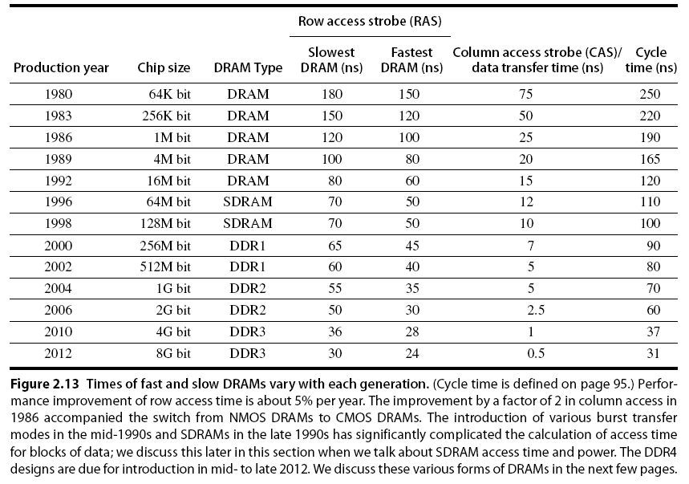
Memory Optimizations
Memory Technology

Slide 21
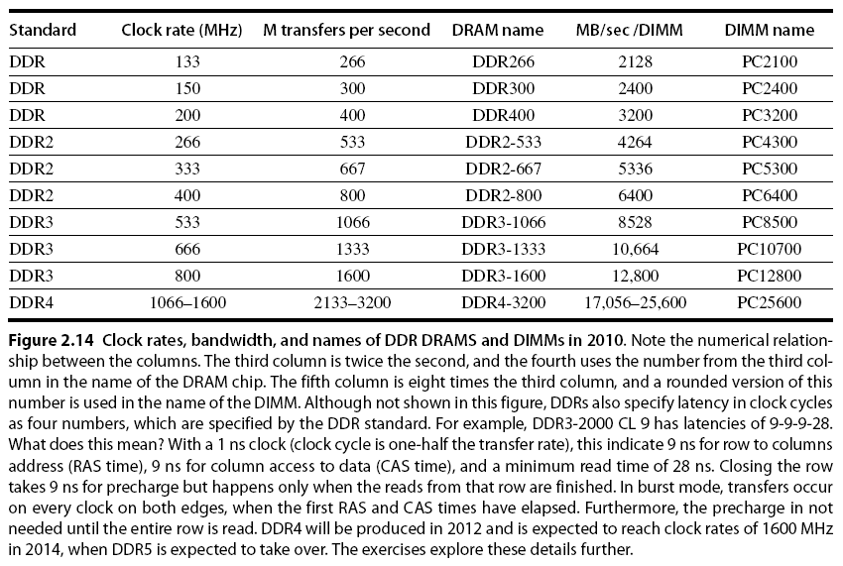
Memory Optimizations
Memory Technology

Slide 22
Memory Optimizations
Memory Technology
DDR (Double Data Rate):
  DDR2
    Lower power (2.5 V -> 1.8 V)
    Higher clock rates (266 MHz, 333 MHz, 400 MHz)
  DDR3
    1.5 V
    800 MHz
  DDR4
    1-1.2 V
    1600 MHz
GDDR5 is graphics memory based on DDR3

Slide 23
Memory Optimizations
Memory Technology
Graphics memory:
  Achieve 2-5 X bandwidth per DRAM vs. DDR3
    Wider interfaces (32 vs. 16 bit)
    Higher clock rate
      Possible because they are attached via soldering instead of socketted DIMM modules
Reducing power in SDRAMs:
  Lower voltage
  Low power mode (ignores clock, continues to refresh)

Slide 24
Summary:
Two Different Types of Locality:
  Temporal Locality (Locality in Time): If an item is referenced, it will tend to be referenced again soon.
  Spatial Locality (Locality in Space): If an item is referenced, items whose addresses are close by tend to be referenced soon.
By taking advantage of the principle of locality:
  Present the user with as much memory as is available in the cheapest technology.
  Provide access at the speed offered by the fastest technology.
DRAM is slow but cheap and dense:
  Good choice for presenting the user with a BIG memory system
SRAM is fast but expensive and not very dense:
  Good choice for providing the user FAST access time.

